Slide 1
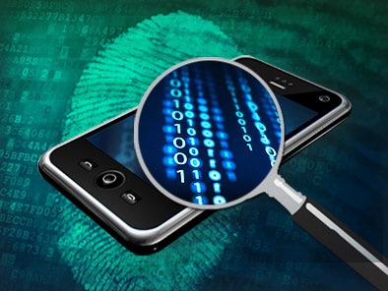
Mobile Device Forensics
1
Notes:
In this lecture, we will study another important topic in digital forensics, mobile device forensics.

Slide 2
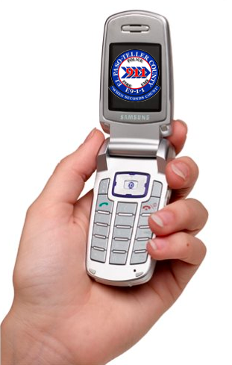
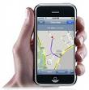
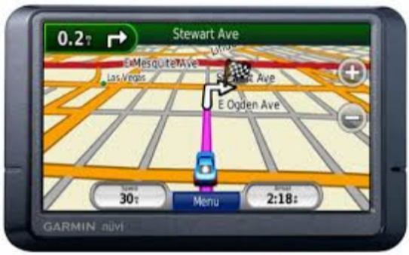
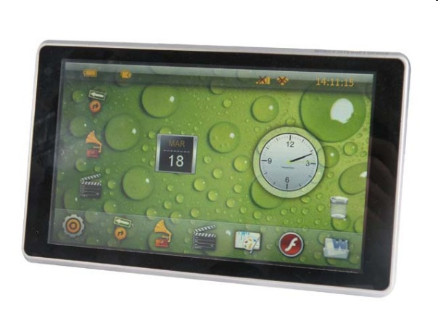
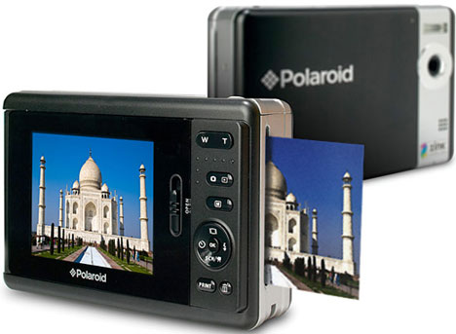
Dose of Reality:
Notes:
Mobile devices have become more prevalent in our society, and evidence relating to crimes will be more frequently found on mobile devices.

Slide 3
Mobile Phone Forensics
3
Notes:
Mobile phones particularly smartphones today, are the most common form of mobile devices. It has translated into strong demand for Mobile phone forensics. Next, we will study Mobile Phone Forensics.

Slide 4

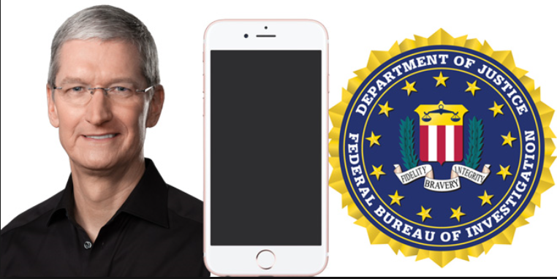

Today’s world
San Bernardino Attack
San Bernardino killer’s phone
FBI doesn’t know four-digit pass code
So ask Apple for help or crack iPhone's security
[1] 2015 San Bernardino attack.
https://en.wikipedia.org/wiki/2015_San_Bernardino_attack
[2] How a new hack put Apple's FBI fight on hold
http://www.theverge.com/2016/3/22/11284396/apple-vs-fbi-encryption-hearing-suspended-result
[3] Israeli firm helping FBI to open encrypted iPhone: report.
http://www.reuters.com/article/us-apple-encryption-cellebrite-idUSKCN0WP17J
Notes:
Unfortunately, it could be a challenging task for Mobile Phone Forensics since it is most likely that a mobile phone is protected (e.g., with a 4-digit passcode) and a user must authenticate himself or herself to unlock the phone.
For example, FBI wants to figure out the motives behind a terrorist attack. FBI was able to find an IPhone used by the killers.
But FBI doesn’t know four-digit pass code, and was unable to unlock it.
So ask Apple for help or crack iPhone's security, but Apple declined by citing its policy.

Slide 5

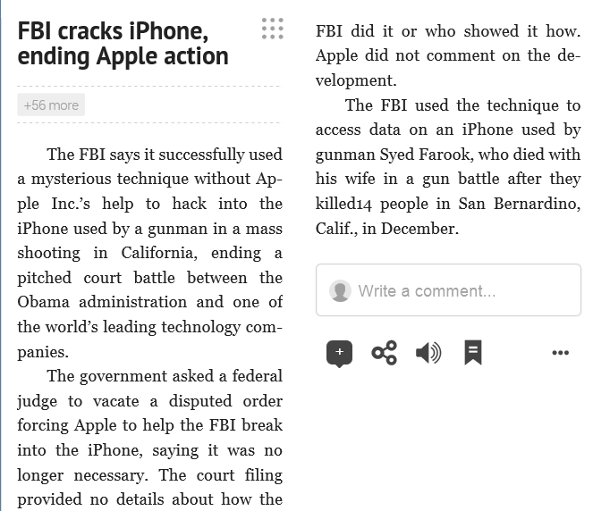
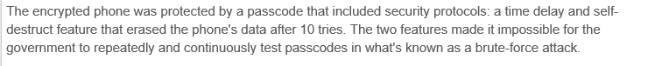
Latest development on San Bernardino Attack (cont’d)
Notes:
The terrorist attack happened in December, 2015. Four months later, in March, 2016, the news says that FBI unlocked the iPhone, citing anonymous sources.

Slide 6

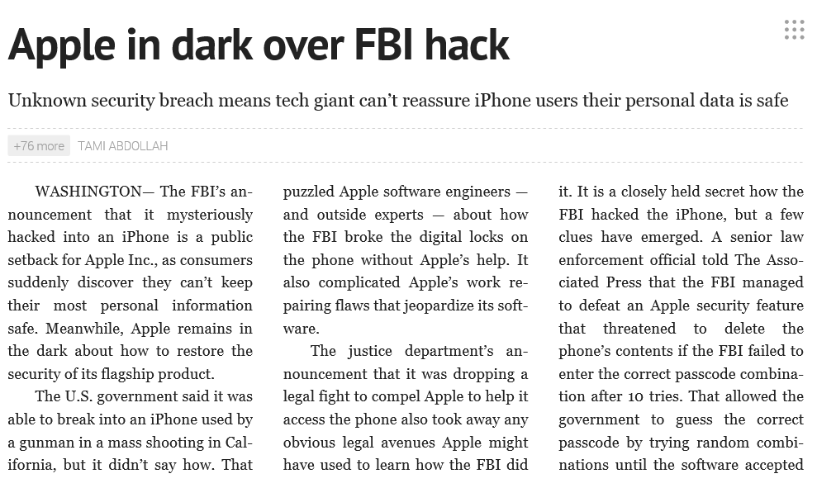
Latest development on San Bernardino Attack (cont’d)
8 days
FBI pays US15278$
Notes:
Anonymous sources stated that Israeli company Cellebrite was assisting the FBI with this task. FBI paid some decent money for the task.

Slide 7

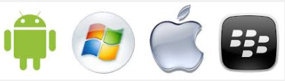


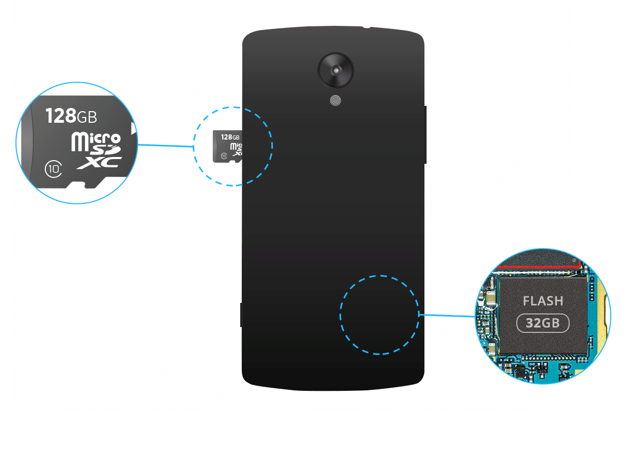
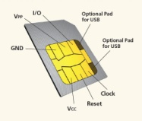
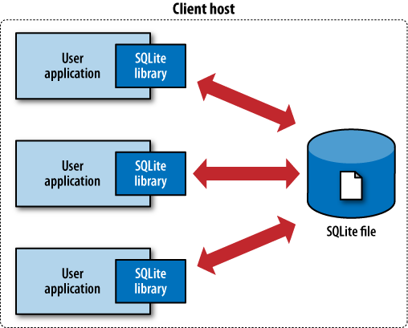


Today’s Mobile Phone (Smartphone)
Mobile Computing platform
GPS
receiver
External Storage
camera
SIM Card
SQLite
Internal Storage
(NAND flash memory)
speaker
7
Notes:
Mobile phone are constantly becoming more sophisticated.
Today’s Mobile Phone (Smartphone) is very powerful.
Because of the available computing power and hardware features (sensors, etc.), the range of applications available for
download (and correspondingly the range of tasks that can be accomplished using
one) is staggering. All of these applications have the potential to store information
locally on the device. For example, instant messaging applications are widely used,
and allow users to share a significant amount of personal information. It is likely that
traces of this data can be found locally in smartphone storage.

Slide 8
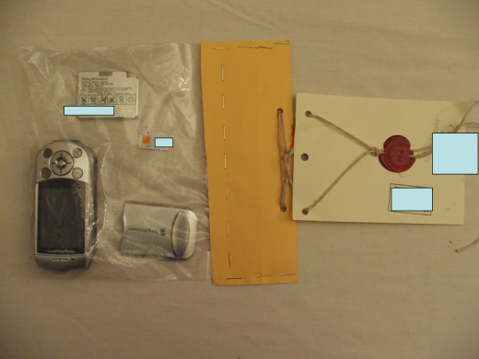
Data on Mobile Phones
Today with Smartphones – GPS Info, Social Networking Data
Apps store browsing history in mobile phones
Mobile phones store every picture you viewed
Typing behavior: Your smartphone stores everything you type to track your typing behavior, like a keylogger
Notes:
Data on Mobile Phones include:
GPS Info, Social Networking Data
Apps store browsing history in mobile phones
every picture you viewed
Typing behavior: Your smartphone stores everything you type to track your typing behavior, like a keylogger

Slide 9
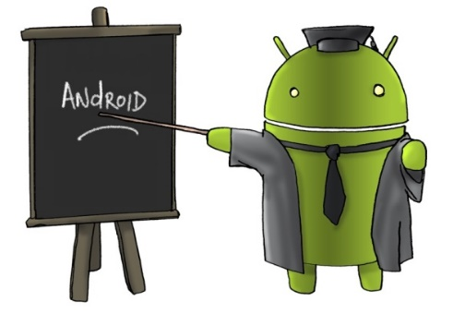
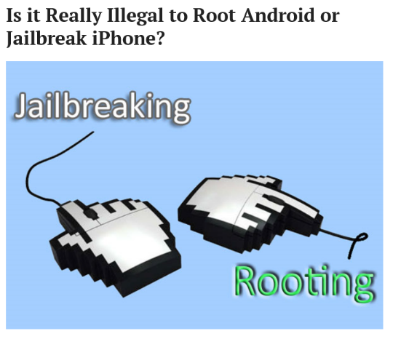
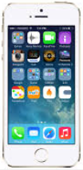

Android Overview
A Free Mobile Operating System
Biggest User Base
Legally Root Privilege for Users
Rich smartphone applications (or apps) in various market places:
Rich Source for Forensic Analysts
Commercial Mobile Data Storage
Flash (or NAND) memory
External SD card
Internal SD card
Jailbreaking
9
Notes:
We will take a look at a particular mobile platform in more detail. As of September 2015, there were approximately 1.4 billion active Android devices worldwide.
There are many applications available for them, and correspondingly the rich set of data (digital evidence) that can be found in local storage.
Most importantly, it is legal to root Android devices. Rooting gives you super user permission, which is required for data acquisition.
However, rooting may void your warranty.
Please note that Apple says that it is illegal to root iPhone, also known as Jailbreaking, though U.S. government declares iPhone Jailbreaking legal.
We will be focusing on Android devices in our class.

Slide 10
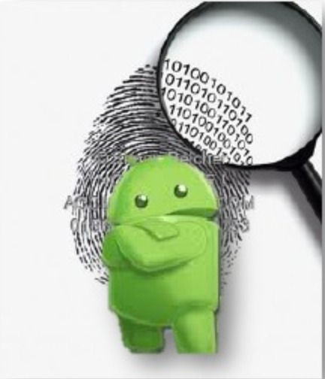
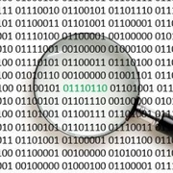
What Can Be Pulled from Today’s Android Devices
Example items stored on Android phones:
Personal calendars
Address books
Incoming/outgoing/lost calls
Music files
Voice recordings (also stored on external flash)
User Name and Password
Mails/SMS Messages
Chat history
Web Browsing history
Pictures/Photos (also stored on external flash)
Most Android phone manufacturers (except very low cost ones) sell or provide tools allowing to manage such data.
Notes:
Example data stored on Android phones include
Personal calendars
Address books
Incoming/outgoing/lost calls
Voice recordings (also stored on external flash)
User Name and Password
Mails/SMS Messages
Chat history
Web Browsing history
Pictures/Photos (also stored on external flash)

Slide 11
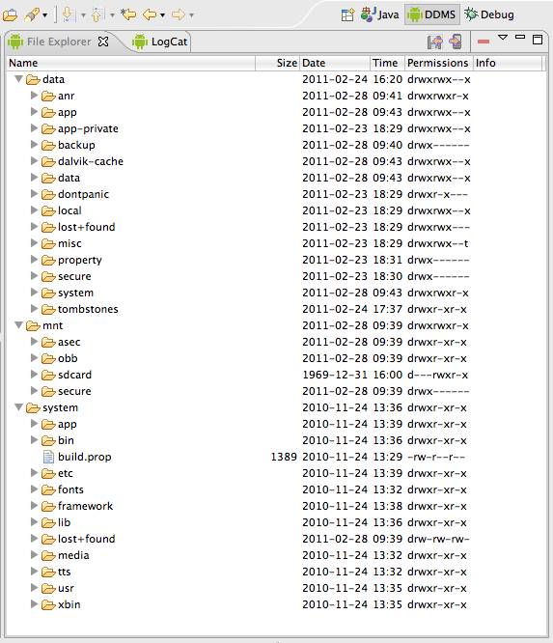
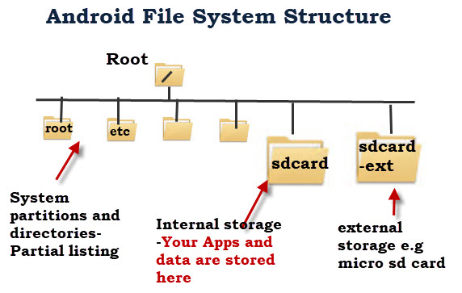
Android File System
Yet Another Flash File System 2 (YAFFS2) after 2004.
11
[1] Marko Gargenta. Learning Android. O'Reilly Media, Inc.
https://www.safaribooksonline.com/library/view/learning-android/9781449304881/ch07s04.html
Notes:
Android device has a special system filesystem. By default, it uses YAFFS - Yet Another Flash File System.

Slide 12

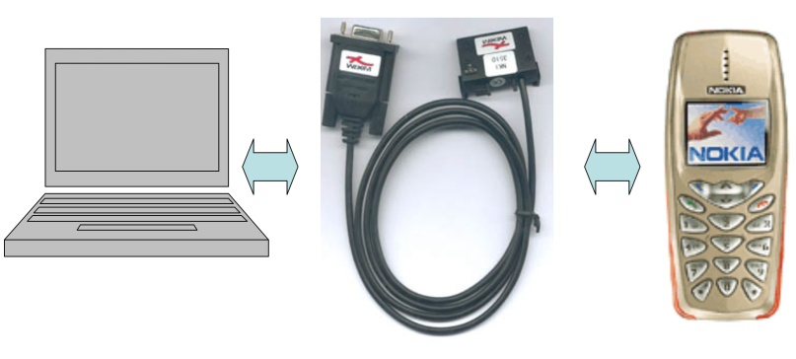
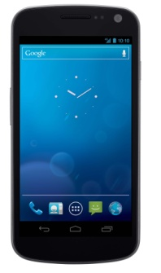
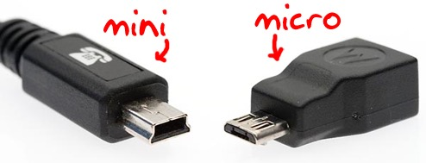
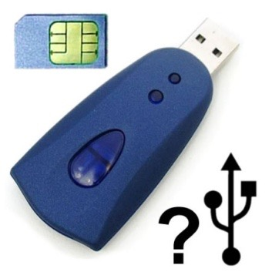
Equipment for Data Acquisition in Android Forensics
Objectives:
Extract SIM PIN codes, privacy data, online activities, secret keys…
Key Equipment:
PC (Forensic workstation)
Cables
SIM Card Reader
12
Notes:
You will need some equipment for Data Acquisition in Android Forensics.
For example, a Forensic workstation, some cables connecting your phone to the Forensic workstation.
A SIM Card Reader to read data from the SIM card.

Slide 13
Data Capture Options
Chip-Off Analysis
Physical Analysis and Alternative Methods for Extraction
Logical Analysis
Screen Capture and Manual Reporting
[1] Bill Teel. Mobile Device Forensics: An Overview. Teel Technologies
Notes:
There are many data capture Options:
Starting from the bottom, the most basic one: Manual Analysis – physical analysis of the phone involving manual manipulation of the keyboard and
photographic documentation of data displayed on the Screen
Logical Analysis - Connect data cable to the handset and extract data. For example, copy the files off the phone.
Physical Analysis – usually need to root the device and then image the internal storage device in the phone
Both logical and physical analysis are the most popular ones.
Chip-Off analysis- Remove memory from the device and read in either second phone or EEPROM reader.
As you move up the pyramid (generally), you will collect more detailed information but also take more time.

Slide 14
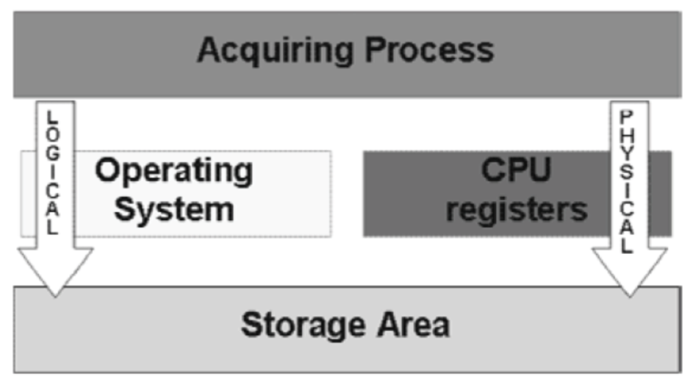
Logical vs. Physical Acquisition
Logical
Physical
Access the file system
No ROOT Requirement
Using command adb pull or other tools to extract
Target the physical memory
ROOT
Hardware-based Forensics
14
Notes:
Logical acquisition is fast, easy, reliable and forensically secure and extract all data (particularly files) from a smart phone like call
logs, contacts, messages, calendar entries, videos, images etc. where as we can create complete image of the memory
using physical acquisition. By using this we can extract even deleted data and even the SIM is not present, which is not
possible using logical acquisition. However, you will need to root the device.

Slide 15
Understanding Acquisition Procedures for Android Phones
Notes:
Next, let us take a look at the standard Acquisition Procedures for Android Phones.

Slide 16
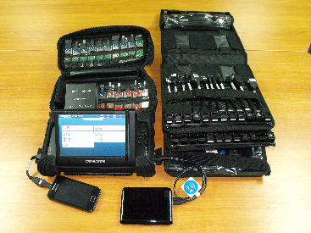
Understanding Acquisition Procedures for Android Phones
The main concerns with mobile devices are loss of power and synchronization with PCs
All mobile devices have volatile memory
Making sure they don’t lose power before you can retrieve RAM data is critical
Mobile device attached to a PC via a cable or cradle/docking station should be disconnected from the PC immediately

Slide 17
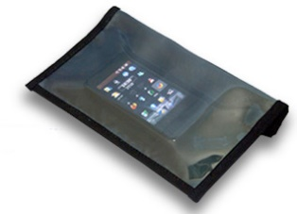
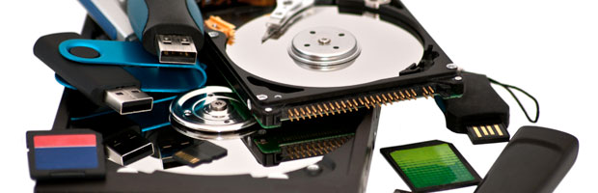
Understanding Acquisition Procedures for Android Phones (Cont’d)
Messages might be received on the mobile device after seizure
Isolate the device from incoming signals with one of the following options:
Place the device in a paint can
Use Wireless StrongHold Bags (faraday bag)
Use eight layers of antistatic bags to block the signal
* Using these isolating options could accelerate battery drainage

Slide 18
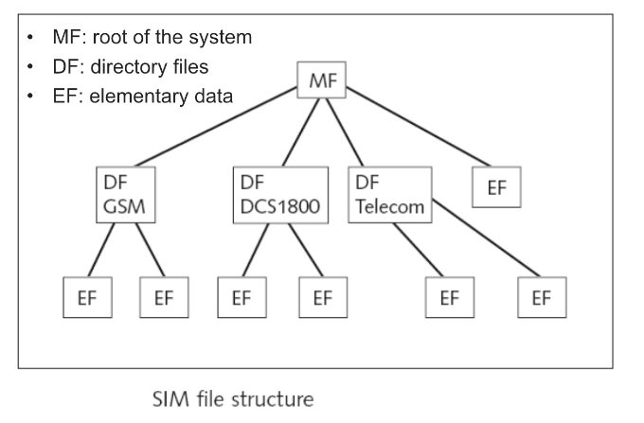
Understanding Acquisition Procedures for Android Phones (Cont’d)
Check the followings in Forensics Lab:
Internal memory
SIM card
SIM card file system is a hierarchical structure
Removable or external memory cards
System server
Checking system servers requires a search warrant or subpoena
* If power has been lost, PINs or other access codes might be required to view files
Notes:
After bringing the mobile device into Forensics Lab:
You will need to acquire the data from the followings
Internal memory, SIM card, and any removable or external memory cards if there is any.
Also, it is possible that you may also need to check some system or cloud server since it is very common that a mobile device uses some cloud storage services. As a result, the majority of the data is stored on the cloud or a remote system server. However, checking system servers requires a search warrant or subpoena.

Slide 19
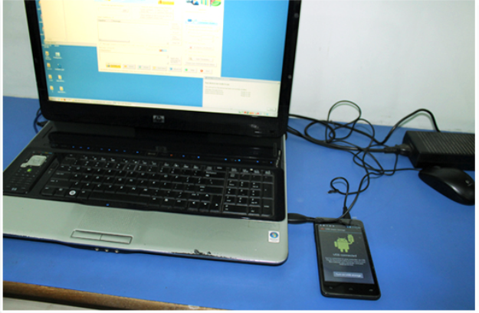
Access Methods
19
Notes:
Next, let us take a look at some popular access methods widely used today.

Slide 20
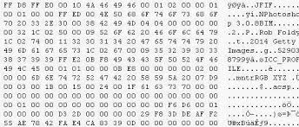
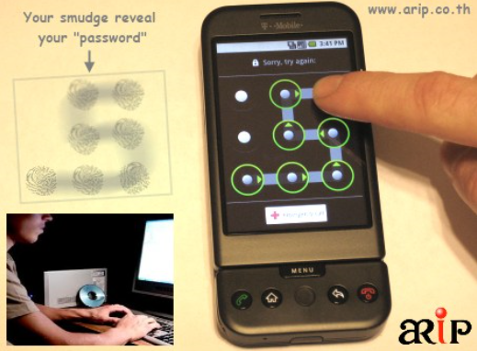
Access Methods
Circumventing Passcodes
Smudge Attack: A method to discern the password pattern (locking grid pattern) of a touchscreen device such as a cell phone or tablet computer. The smudge attack relies on detecting the oily smudges left behind by the user's fingers when unlocking the phone using a secure pattern grid.
[1] http://www.perfectclean.com/pdf/SMUDGE_ATTACKS.pdf
20
Notes:
In order to access the phone, one way is to circumventing passcodes used to protect the phone.
One possible method is to use Smudge Attack: A method to discern the password pattern (locking grid pattern) of a touchscreen device such as a cell phone or tablet computer. The smudge attack relies on detecting the oily smudges left behind by the user's fingers when unlocking the phone using a secure pattern grid.

Slide 21
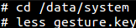
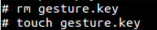
Access Methods (Cont’d)
Circumventing Passcodes (cont’d)
Pattern Lock Vulnerability
Pattern Lock creates a file
gesture.key
Hash of the pattern stored
If custom recovery ROM (or custom operating systems) is installed (i.e. ClockWorkMod Recovery)
Remove & recreate key to bypass pattern
[1] Shawn Valle. Android Forensics and and Security Testing, 2012.
[2] ClockworkMod. https://en.wikipedia.org/wiki/ClockworkMod
21
Notes:
Another possible method is to exploit Pattern Lock Vulnerability.
For example, Pattern Lock creates a file, gesture.key, which stores the hash of the pattern.
If you are able to gain access to the file, for example,
installing a custom recovery ROM (or custom operating systems) to boot the phone so
you can access the key pattern file.
Afterwards, you can some hacking technique you have learned, such as rainbow table attack, to find out the pattern.

Slide 22
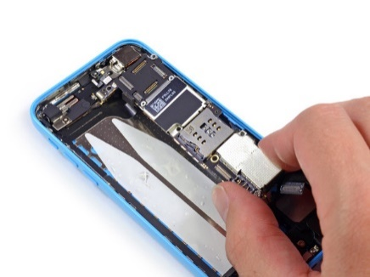
Access Methods (Cont’d)
Circumventing Passcodes (cont’d)
NAND mirroring
The technique involves removing NAND storage from a device or phone, copying it using a chip reader, and then reattaching the original chip to the phone.
[1] 'NAND mirroring' could let FBI break into iPhone without Apple's help, researchers say.
http://appleinsider.com/articles/16/03/23/nand-mirroring-could-let-fbi-break-into-iphone-without-apples-help-researchers-say
22
Notes:
Another method is NAND mirroring.
The technique involves removing NAND storage from a device or phone, copying it using a chip reader, and then reattaching the original chip to the phone.
It is a Chip-Off method. So you don’t need to know the passcodes used to protect the phone.
While this method extracts all data from mobile phone memory, but it is expensive.
Also, we need to make sure that the data is not encrypted.

Slide 23
Access Methods (Cont’d)
Circumventing Passcodes (cont’d)
ADB and USB Debugging
Enable USB debugging of a device and use Android Debug Bridge (adb) with the device connected over USB.
ADB is a versatile command line tool that lets you communicate with an emulator instance or connected Android-powered device
23
Notes:
Next, we assume you know the passcodes used to protect the phone. So you can unlock the phone.
Then, you can enable USB debugging of a device and use Android Debug Bridge (adb) with the device connected over USB.
ADB is a versatile command line tool that lets you communicate with an emulator instance or connected Android-powered device.
Afterwards, you are able to pull the files out of the Android device, for example, using command adb pull.

Slide 24

Access Methods (Cont’d)
ROOT
Rooting is the process of allowing users of smartphones, tablets and other devices running Android to attain privileged control (known as root access) over various Android subsystems.
As Android uses the Linux kernel, rooting an Android device gives similar access to administrative (superuser) permissions as on Linux or any other Unix-like operating system such as FreeBSD or OS X.
[1] Rooting (Android OS). https://en.wikipedia.org/wiki/Rooting_(Android_OS)
24
Notes:
You can also root the Android device. Rooting gives you super user permission. As such, you can image the internal storage device in the phone.

Slide 25

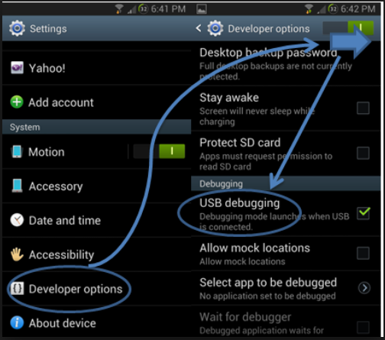
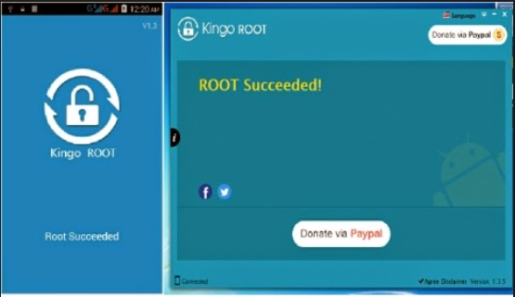
Notes:
This is an example of an Android phone, which has been rooted.

Slide 26
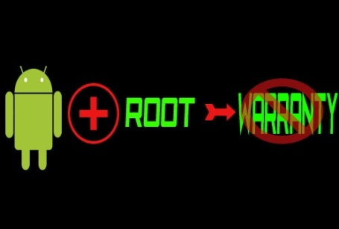
ROOT in Android Devices
Needed for many forensic techniques, including physical acquisition
Not enabled on any device by default
Gaining ROOT isn’t always the best choice in forensics
It will change data on the device, possibly altering evidence
It will be time consuming to gain root, as it’s implemented differently across most devices
Root makes the device vulnerable to many exploits
26
Notes:
Rooting is needed for many forensic techniques, including physical acquisition
But, not enabled on any device by default.
Technically speaking, it is kind of privilege escalation in cyber security.
However, please be advised that gaining ROOT isn’t always the best choice in forensics:
This is because of some reasons:
It will change data on the device, possibly altering evidence
It will be time consuming to gain root, as it’s implemented differently across most devices
Root makes the device vulnerable to many exploits.

Slide 27
Three Common Types of ROOT
Temp ROOT – ROOT the device only until it is rebooted, which then disables root
Perm ROOT – ROOT persists after reboots. Commonly enabled with custom ROMs
Recovery Mode ROOT – flashing (installing) a custom recovery partition, allowing root to run only in recovery mode
[1] Nathan Scrivens, Xiaodong Lin, "Android digital forensics: data, extraction and analysis," ACM TUR-C 2017
27
Notes:
There are three common types of ROOT, including
Temp ROOT – ROOT the device only until it is rebooted, which then disables root Perm ROOT – ROOT persists after reboots. Commonly enabled with custom ROMs Recovery Mode ROOT – flashing (installing) a custom recovery partition, allowing root to run only in recovery mode

Slide 28
Main Tools for Android Forensics
Android SDK (Software Development Kit)
AVD (Android Virtual Device)
ADB (Android Debug Bridge)
28
Notes:
There are some tools widely used for Android Forensics, including
Android SDK (Software Development Kit)
AVD (Android Virtual Device)
ADB (Android Debug Bridge)

Slide 29
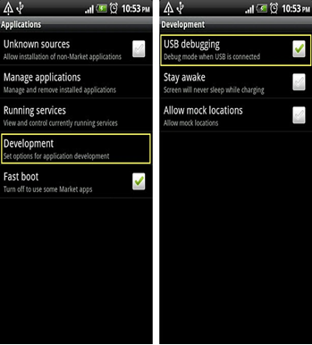
USB Debugging
Enable USB debugging on device
Applications> Development > USB Debugging
This will run adb daemon (adbd) on device.
adbd runs as a user account, not an admin account. No root access. Unless your device is rooted, then adbd will run as root.
If the device is locked with a pass code, enabling USB debugging is difficult.
29
Notes:
In Android forensics, Android Debug Bridge (ADB) plays a very crucial role.
In order to work with ADB, the USB-debugging option needs to be enabled.
Please note that enabling USB-debugging in an Android device will run adb daemon (adbd) on device.
adbd runs as a user account, not an admin account. No root access. Unless your device is rooted, then adbd will run as root.
If the device is locked with a pass code, enabling USB debugging is difficult.

Slide 30
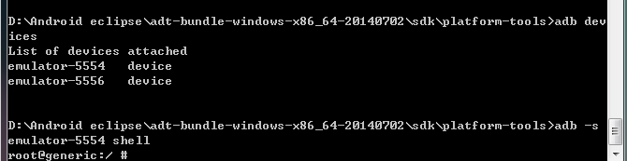
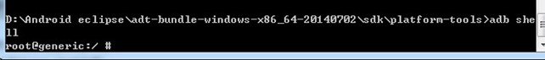
Basic ADB commands
ADB Devices to identify devices connected, use command adb devices
ADB Shell, To open an adb shell on only one connected Android device, use command adb shell
For more commands: http://developer.android.com/tools/help/adb.html
30
Notes:
Afterwards, you can access the file system on the Android device through the Android Debug Bridge (ADB) by connecting to the device.

Slide 31


Online Account Credentials Investigation
Kingo root
andriller
Notes:
Next, we will do a case study to find out Online Account Credentials on an Android device.

Slide 32
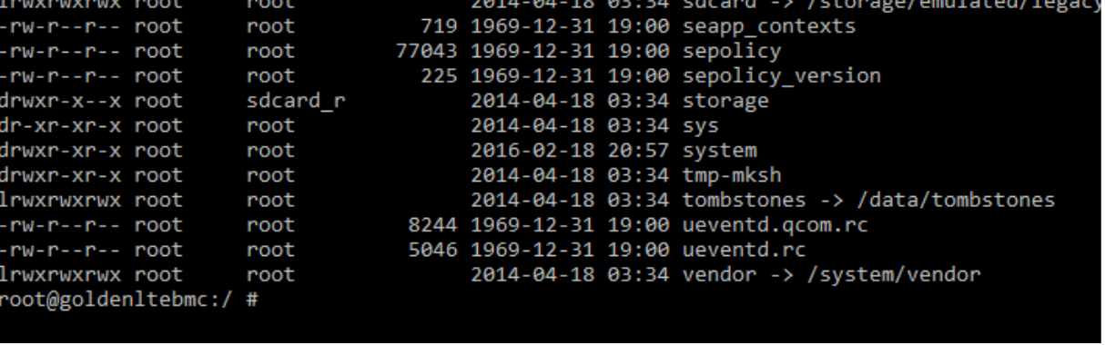
Step 1 : ROOT Your Android Phone
Using any free tools to root Android Phone, such as “Kingo Root”^{[1]}
Connect to the ADB with “adb shell”, then “su”
[1] Kingo root, https://www.kingoapp.com.
32
Notes:
First, we use any free tools to root Android Phone, such as “Kingo Root”. Then, connect to the ADB with “adb shell”, then “su”

Slide 33
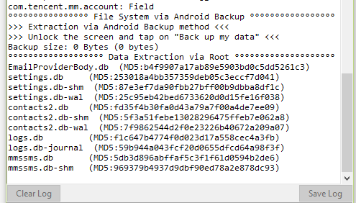
Step 2: Using analysis tools to investigate Android devices
Analyzing tools, such as “andriller”^{[1]}
Pull out the critical files from an Android system, such as log files and browser history
[1] Andriller, http://andriller.com.
33
Notes:
Afterwards, we use some analyzing tools, such as “andriller” to pull out the critical files from an Android system, such as log files and browser history

Slide 34
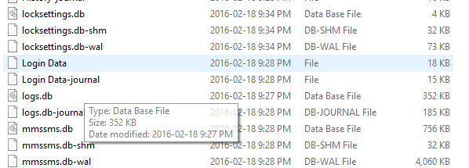
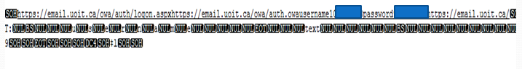
Step 3: Find the Browser Histroy
User Name and Password will be displayed as a plaintext
34
Notes:
By inspecting browser history on the Android device, you may find some Online Account Credentials.
This is an example of showing User Name and Password in the plaintext.

Slide 35
Challenges in Mobile Phone Forensics
Password security
Security mechanisms used on mobile phones to protect data (Encryption)
Various proprietary mobile operating systems
Accidental wiping or resetting
Lack of tools and equipment
Anti-forensic techniques
[1] Five continual challenges with smartphone forensics
https://www.msab.com/blog/five-continual-challenges-with-smartphone-forensics/
35
Notes:
There are some challenges in mobile phone forensics.

Slide 36


Challenges in Mobile Phone Forensics (cont’d)
A security flaw in Apple iPhone allows a hacker to allowed the white hat hacker to access all the files stored on the targeted devices that include emails, notes, images, location data, etc. [1]
Mobile Phone Security
Mobile Phone Forensics
[1] An iOS zero-click radio proximity exploit odyssey
https://googleprojectzero.blogspot.com/2020/12/an-ios-zero-click-radio-proximity.html
[2] Google Hacker Found a Way to Hack iPhones Remotely Through WiFi.
https://www.pandasecurity.com/en/mediacenter/mobile-security/google-hacker-iphones/
36
Notes:
This is the future research direction, using hacking method to gain access to the phone which is locked.

Slide 37
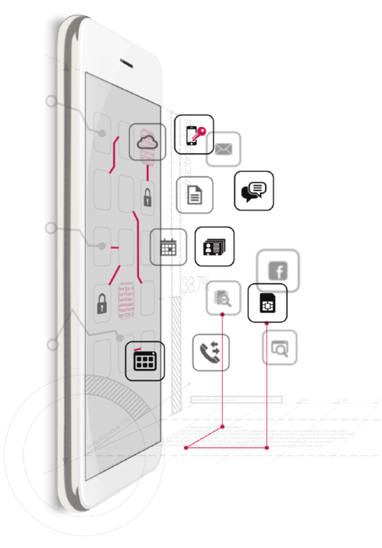
MOBILedit Forensic
37
Notes:
Some big players in the field

Slide 38
GPS Forensics (SatNav Forensics)
[1] Garmin satnav forensic methods and artefacts: an exploratory study.
http://researchrepository.napier.ac.uk/7334/
38
Notes:
Next, we take a look at another popular mobile device widely used today, GPS device.

Slide 39

Introduction to GPS
The Global Positioning System (GPS) is a radio-navigation system available worldwide.
GPS is formed from a constellation of 24 satellites in 6 evenly spaced orbits (6 orbital planes).
There are in fact 32 of them. Only 24 are required to cover the entire earth.
Each of these satellites take 11 hours and 58 minutes to orbit the Earth.
Satellites are 20,350 km from earth, weighs ~900 kg and ~6 meters across
Civilian frequency used is 1575.42 MHz, which is in UHF band.
There are five ground stations that make sure the satellites are working properly
[1] http://www.metaresearch.org/cosmology/gps-relativity.asp
Notes:
In order to understand GPS Forensics, we will first need to understand the fundamentals of the Global Positioning System.
The Global Positioning System (GPS) is a radio-navigation system available worldwide.
It is based on observations of signals transmitted from satellites.
There are total 32 satellites, but only 24 are required to cover the entire earth.

Slide 40
Introduction to GPS (cont’d)
satellites
Radio Waves
40
Notes:
GPS is based on observations of signals transmitted from satellites.
By precisely measuring the travel time of the signal, a receiver can precisely calculate how far away it is from the satellite

Slide 41
Introduction to GPS (cont’d)
Distance measurements from two satellites limits our location to the intersection of two spheres, which is a circle.
41
Notes:
Distance measurements from two satellites limits our location to the intersection of two spheres, which is a circle.

Slide 42

Introduction to GPS (cont’d)
A GPS receiver uses trilateration to determine its position on the surface of the earth by timing signals from three satellites in the Global Positioning System.
GPS Trilateration
[1] http://www.mio.com/technology-trilateration.htm
42
Notes:
A GPS receiver uses trilateration to determine its position on the surface of the earth by timing signals from three satellites in the Global Positioning System.

Slide 43
Introduction to GPS (cont’d)
Four measurements determine which point is our true location
43
Notes:
In reality, four measurements determine which point is our true location.

Slide 44
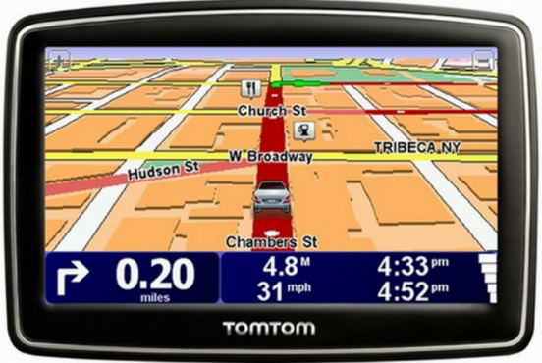
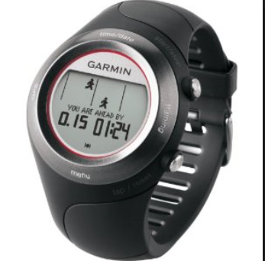
Dose of Reality:
Notes:
There are many different GPS devices available today.

Slide 45
Why GPS forensics?
GPS devices present in all kinds of cases
Homicide
Smuggling
Kidnapping
Burglary
Accident Investigation
Arson
Notes:
Why GPS forensics?
The law enforcement community has seen an increasing use of Global Positioning System (GPS) device as an instrument of crime, or as a “witness device”, due to a feature that autonomously collects and logs positional data during the crime. GPS devices are becoming an integral part of many investigations, for example, Homicide, Smuggling, and Kidnapping.

Slide 46







Today’s GPS
Internet
Cloud
GPS
receiver
SD Card
Bluetooth
Flash Memory
Notes:
This is a typical GPS device today. It is a very sophisticated device, and consists of the followings, including
GPS receiver, internal or external storage device, Built-in map, and network connectivity.

Slide 47



Garmin GPS Devices
The most widespread
Linux-based Operating System
Covering a Wide Range (Maritime and Aviation)
47
Notes:
There have been plenty of portable GPS devices, but Garmin and TomTom units are by far the most popular ones used by the public.
We will take a look at some Garmin GPS Device.

Slide 48


Data on GPS Devices
Privacy Data inside, such as Location Information
Evidence of a criminal act or information of interest
Track logs
Track points
Stored Location; Home, Office, etc…
Recent Address
Call Logs (Missed, Dialed, Received)
Video, Photos, Audio
[1] Resources: http://www.gpsforensics.org
48
Notes:
There are rich data which can be found on GPS devices. For example,
Location Information, Call Logs (Missed, Dialed, Received), and Video, Photos, Audio.

Slide 49




Tools used for Garmin Forensics
Faraday Bag
USB Write Blocker
AccessData FTK Imager
Google Earth
49
Notes:
Some popular tools used for GPS forensics, particularly Garmin Forensics here.
For example
Faraday Bag: used to block out wireless signals for GPS devices.
USB Write Blocker: used for write blocking when connecting the GPS device to a forensics workstation
AccessData FTK Imager: used to create a forensic image of internal memory of GPS device
Google Earth: used to display the tracks or the movement of the suspect on a Map.
,

Slide 50


GPS eXchange Format (GPX)
XML
Waypoint
Route
Track
GPS coordinates (latitude and longitude)
[1] https://en.wikipedia.org/wiki/GPS_Exchange_Format
50
Notes:
Next, I will introduce some popular terms widely used in GPS navigation.
The GPS exchange format (GPX) is the standard XML format for recording GPS data and exchanging GPS data between applications (and GPS
devices). In a GPX file, you can find Waypoint, Route, and Track. The location uses GPS coordinates (latitude and longitude).

Slide 51
GPS eXchange Format (GPX) (cont’d)
waypoints:
geographic locations defined by a GPS device user using their coordinates or addresses, or some other Point of Interest (POI) so that they will be travelled through.
route
A route is a path from the starting point (by default, the current location) of a trip to the destination defined by the user.
track
A history of where GPS device users have been, and when. A track consists of many track points or geographic locations where GPS device users have been travelling through.
One track can contain multiple segments. All track points inside a segment are drawn as one continuous line.
51
Notes:
Next, we take a look at some important terms used in GPS eXchange Format (GPX).

Slide 52
GPS eXchange Format (GPX) (cont’d)
Garmin GPX files
Items of significance used in Garmin GPX files
Waypoint
Route
Track Point
Track Segment
User can interact with
Waypoint
Route
On the system level there are
Track Point
Track Segment
52
Notes:
Some of the significance used items in Garmin GPX files are Waypoint, Route, Track Point and Track Segment.
The ones that the user can interact with are Waypoint and Route. On the system level, there are Track Point and Track Segment.

Slide 53

User Interface
Waypoint- Specific Location Information Storage
Route- A set of Waypoints
53
Notes:
The user can store information in Garmin nüvi 1350, for example, by defining waypoints. A waypoint in this case is a location on earth the user stored in the
GPS.
Note that Existence of waypoint alone doesn’t mean that the user was at that particular location. Waypoint could be a location that the user entered that he/she wanted to navigate to, in future. It could also be a location stored by the user where he/she was physically present.
If a user wants to navigate a series of waypoints in a specific order, then it is a route. In other words, a route is defined by the user. After reaching a waypoint, the unit guides the user to the next waypoint.

Slide 54
System Level
Track Point: Location Recording with Detailed Information (Timestamp, Speed and Coordinate, etc)
Track Segment: A Collection of Track Points
GPX files
54
Notes:
The track point shows the location recorded by the GPS regarding where it was, provided the unit was turned on and it had established satellite links. This record carries the timestamp, latitude, longitude, and elevation.
A Track Segment is a Collection of Track Points

Slide 55

Difference between Route and Track
Route
User Defined
Track
System Generated
55
Notes:
The difference between route and track is:
Route is defined by the user, and Track is generated by the system.

Slide 56
Replay Route Suspect Took
FTK Imager
Google Earth
Notes:
Next, we will do a case study by replaying route a suspect took.

Slide 57

Step 1: Display the Route of Tracks
Obtain the GPS image gps.dd and open .gpx.
57
Notes:
First, we will use FTK Imager to image the GPS used by the suspect. Afterwards, we can extract and open .gpx files in Google Earth.

Slide 58


Step 2: Navigation
58
Notes:
Then, you can choose a Track you are interested in, and click on “Start” button, we can get an overview of the movements.

Slide 59



Step 3: Display Detailed Real Information
59
Notes:
You can navigate to each place the suspect has visited and take a look at it in more detail.

Slide 60



Dose of Reality:
Notes:
Now we are living in a digital world, people increasingly continue to use electronic devices in their daily lives, for example, taking photos.

Slide 61

Dose of Reality
In digital world, a lot of documents and files created by applications contains important evidences, which may provide useful leads for the investigation and/or catch criminals.
Notes:
In digital world, a lot of documents and files created by applications contains important evidences, which may provide useful leads for the investigation and/or catch criminals.

Slide 62



Image (Photo) Forensics
Notes:
Next, we will take a look at Image (Photo) Forensics.

Slide 63


Dose of Reality:
Advances in digital imaging technologies led to development of low-cost and high-resolution digital cameras and scanners, which become very popular recently
Notes:
Advances in digital imaging technologies led to development of low-cost and high-resolution digital cameras and scanners, which become very popular recently.

Slide 64
Dose of Reality: (cont’d)
Trace who is the owners of images and their originating devices by linking digital images back to their digital source
Almost all digital cameras store extra information, called metadata, with your pictures. The extra information captured by your camera is called EXIF data, which stands for Exchangeable Image File Format.
Notes:
Almost all digital cameras store extra information, called metadata, with your pictures. The extra information captured by your camera can be used to trace back to who is the owners of images and their originating devices by linking digital images back to their digital source
The extra information captured by your camera is called EXIF data, which stands for Exchangeable Image File Format.

Slide 65
Exchangeable Image File Format
Exchangeable Image File Format (Exif), a specification for the image file format used by digital cameras.
The specification uses the existing JPEG, TIFF Rev. 6.0, and RIFF WAV file formats, with the addition of specific metadata tags. It is not supported in JPEG 2000, PNG, or GIF.
The metadata tags defined in the Exif standard cover a broad spectrum:
Date and time information. Digital cameras will record the current date and time and save this in the metadata.
Camera settings. This includes static information such as the camera model and make, etc.
A thumbnail for previewing the picture on the camera's LCD screen, in file managers, or in photo manipulation software.
Descriptions and copyright information.
Geolocation if cameras have a built-in GPS receiver.
[1] Exchangeable image file format. http://en.wikipedia.org/wiki/Exchangeable_image_file_format
Notes:
Exchangeable image file format (Exif) is a standard that specifies the formats for images and sound used by digital cameras (including smartphones), which
handle image and sound files recorded by digital cameras.
It contains rich information, which are very helpful for digital forensic investigation.
For example, it contains Date and time information. So you know when the photo was taken.
Also, it contains Geolocation if cameras have a built-in GPS receiver. Then, you know where the photo was taken.

Slide 66

EXIF Image File Directories (IFDs)
IFD | Description
Camera | Information about the camera that took the photo, and the picture taking conditions at the time the picture was taken
Image | Camera settings used to take the image
Thumbnail | Information about the thumbnail image
Interoperability | Information about the version of the EXIF Specification used to create the image file
GPS | Information about the location and orientation of the camera at the time the image was taken (using the satellite Global Positioning System)
Maker Note | Information specific to the make and model of camera used
Not all IFDs will be present in all images, and not all IFDs will contain all the possible fields that can be included within that type of IFD. Each camera manufacturer chooses the set of fields each of their camera models will include.
Notes:
The EXIF data are organized into Image File Directories (IFDs). An IFD contains information about the image as well as pointers to the actual image data.
For example, GPS IFD contain information about the location and orientation of the camera at the time the image was taken (using the satellite Global Positioning System).
Please note that the standard defines many IFDs, but not all IFDs will be present in all images, and not all IFDs will contain all the possible fields that can be included within that type of IFD. Each camera manufacturer chooses the set of fields each of their camera models will include.

Slide 67


Dose of Reality:
A photo taken with a GPS-enabled camera can reveal the exact location and time it was taken. It has become important information to trace suspect on the run.
Track Down and Arrest Suspects
Notes:
Next, let us take a look at a real case to see how Image (Photo) Forensics is used to capture some famous fugitives or criminals.
Please note that a photo taken with a GPS-enabled camera can reveal the exact location and time it was taken. It has become important information to trace suspect on the run.

Slide 68
Dose of Reality: (cont’d)
Examples:
Suspected Anonymous Hacker, Ochoa, Busted By FBI because of A Photo
In December 2012, anti-virus programmer John McAfee was arrested in Guatemala while fleeing from alleged persecution. Vice (magazine) had published an exclusive interview with McAfee "on the run" that included a photo of McAfee with a Vice reporter taken with an iPhone 4S smart phone. The photo's metadata included GPS coordinates locating McAfee in Guatemala, and he was captured two days later.
Notes:
For example, a suspected anonymous hacker, Ochoa, got caught by FBI because of a published photo he took during an interview in his place. The photo's metadata reveals his place.
Also, In December 2012, anti-virus programmer John McAfee was arrested in Guatemala while fleeing from alleged persecution. His arrest is also because of a published photo which John McAfee took during an interview. The photo's metadata included GPS coordinates locating McAfee in Guatemala, and he was captured two days later.

Slide 69
Evolution of formats of metadata for photos
EXIF
IPTC
XMP
IPTC, the standard developed
by the International Press
Telecommunications Council.
known as the IPTC Information
Interchange Model (IIM).
XMP, the "Extensible Metadata
Platform" developed by Adobe.
Notes:
The formats of metadata for images has gone through several evolutions.
Exchangeable image file format (Exif) was the first standard for the formats of metadata for photos, widely used today.
International Press Telecommunications Council (IPTC) metadata is another metadata format. It contains more information about an image. For example, you’ll find Title, Description, Keywords, Photographer’s Information, Copyright and much more.
Extensible Metadata Platform (XMP) metadata is a recent format, adopted by Adobe. It essentially incorporates all the information from IPTC metadata.
It also allows more information to be stored within an image.

Slide 70


Image Metadata Analysis
EXIFutils
Notes:
Next, let us do a case study using some Exif analysis tool, called EXIFutils.

Slide 71


Image Metadata Analysis
Analyze Image taken by digital camera
exiflist -o dn image.jpg | more
[1] EXIF, IPTC, XMP Software - Metadata Readers, Editors, Extraction Tools
http://graphicssoft.about.com/od/exifsoftware/EXIF_IPTC_XMP_Software_Metadata_Readers_Editors_Extraction_Tools.htm
Notes:
This example shows the photo named image.jpg, was taken by a digital camera. The model of the digital camera is Sony DSC-W210.
[click]
This kind of information could be very helpful to locate the owner of the digital camera since we can narrow down the search to the list of people who own a Sony DSC-W210.

Slide 72


Image Metadata Analysis (cont’d)
Analyze Image taken by cell phone
exiflist -o dn image.jpg
Notes:
This example shows the photo named image.jpg, was taken by a cell phone. The model of the cell phone is BlackBerry 8900 by Research In Motion.
[click]
Similar to the previous case study, this kind of information could be very helpful to locate the owner of the cell phone since we can narrow down the search to the list of people who own a BlackBerry 8900.

Slide 73

Reading materials
Chapters 15 and 16

